Slide 1
Voice over IP – A Beginners Guide
Dr. Jonathan Rosenberg Vice President and Chief Technology Officer of Collaboration at Cisco Systems

Slide 2
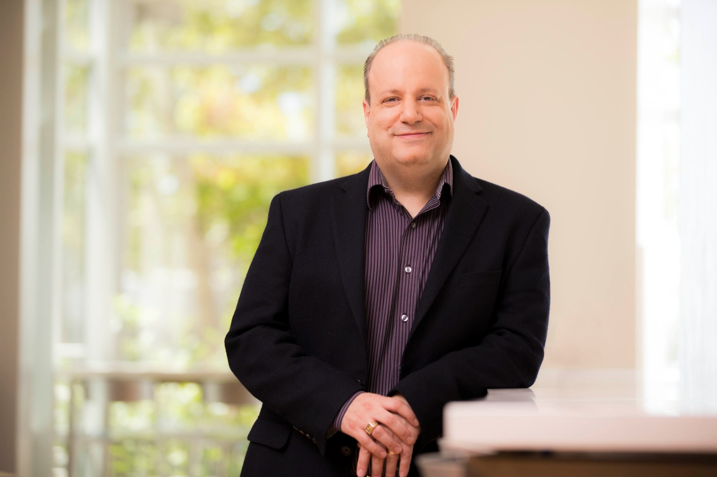
About Me
Bachelors and Masters 1994
Electrical Engineering
PhD, Voice over IP 2001

Slide 3
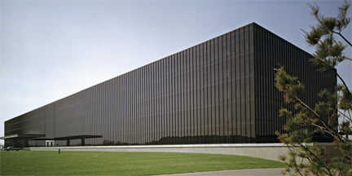
Member of Technical Staff, Bell Laboratories, Holmdel

Slide 4
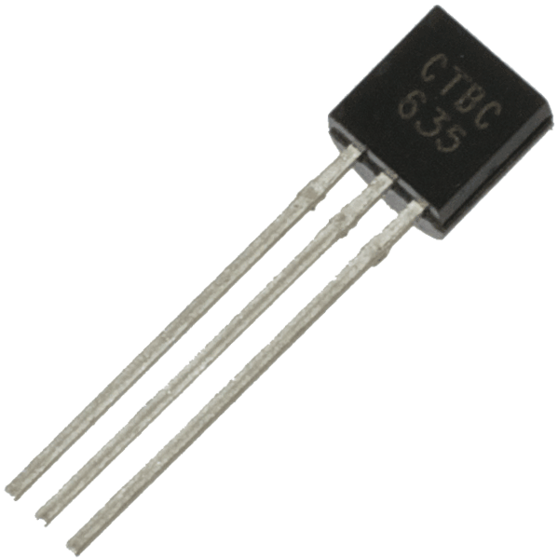
Birthplace of the Transistor
Water Tower at Holmdel Site
Coincidence or on Purpose?
You decide!
Transistor

Slide 5
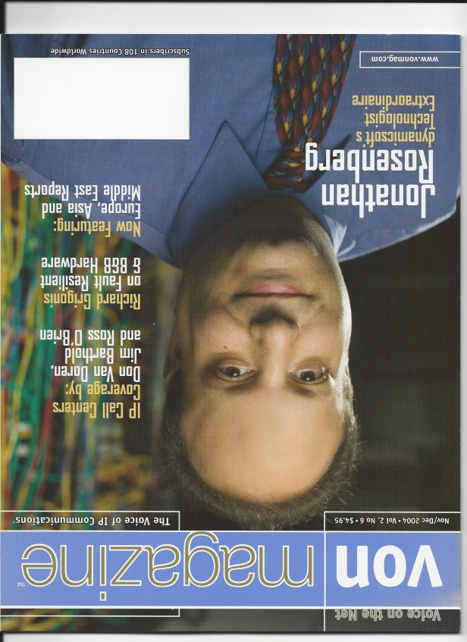
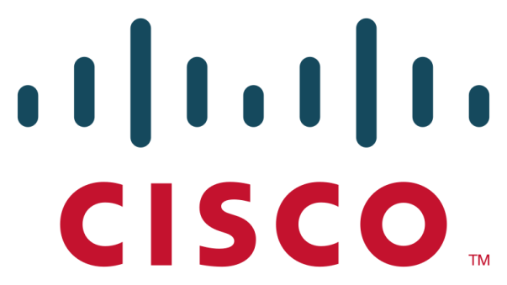
Chief Technology Officer, dynamicsoft
Acquired 2004
Left 2009

Slide 6
Chief Technologist, Skype
Left 2012

Slide 7
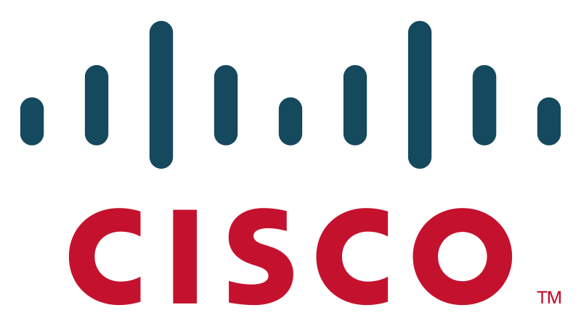
CTO, Collaboration at Cisco

Slide 8
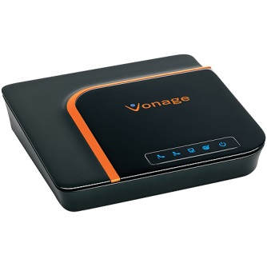
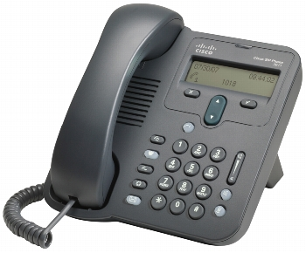
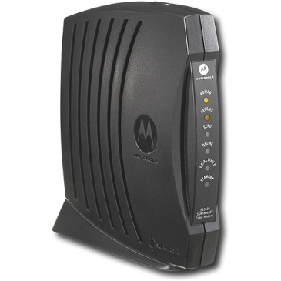
Co-Inventor and Lead Author of the Session Initiation Protocol (SIP)
SIP is the fabric that connects all modern telecom products and services
Billions and billions of minutes of calls
The Phone Network is ~50% converted to SIP and will be completely built on SIP by 2020ish

Slide 9
My Career Mission
To Reimagine Telecommunications in the
Image of the Internet

Slide 10
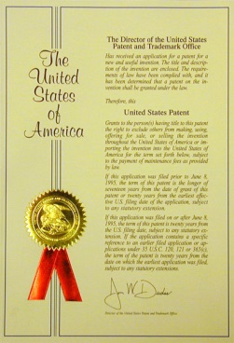
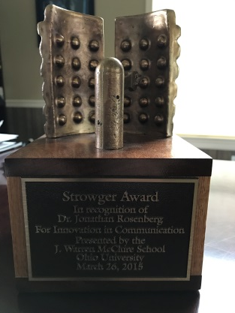
Awards and Accomplishments
Named to TR35 in 2002, along with Sergey Brin, Larry Page, John Carmack
~125 filed,
89 Granted US Patents
2015 Ohio University Strowger award for pioneering contributions to telecommunications
71 Internet Standards,
8th most prolific creator of Internet standards of all time

Slide 11
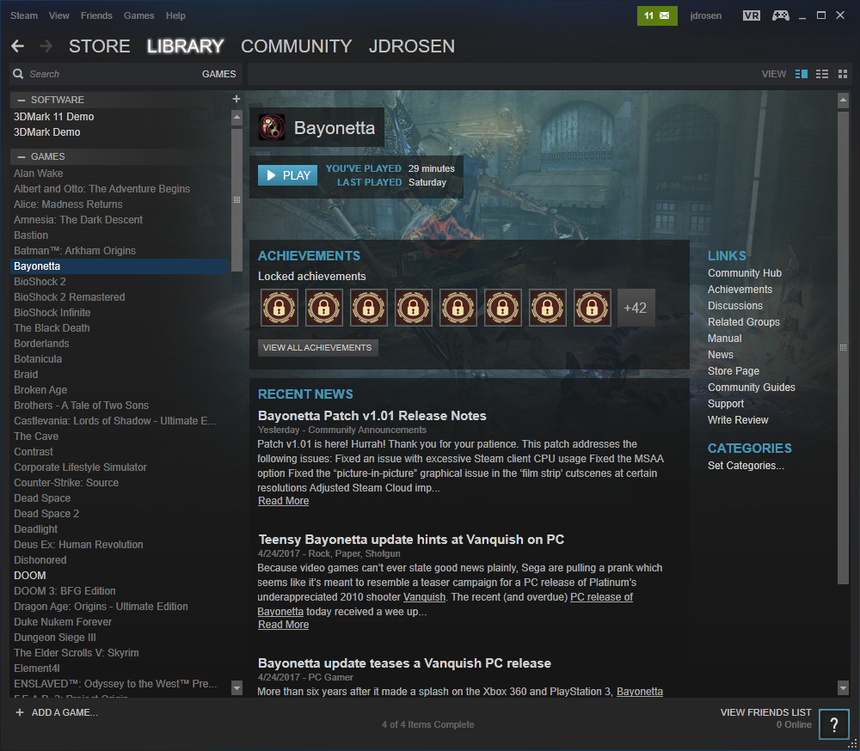
jdrosen on Steam
135 titles!
Half Life 2
World of Warcraft
Portal 2
Ori and the Blind Forest
Alice: Madness Returns
The Last of Us
Uncharted 3
Rise of the Tomb Raider
Tomb Raider (2013)
Portal 2
Prince of Persia: Sands of Time
Doom (2016)
Prince of Persia: The Forgotten Sands
Limbo
Portal
Legend of Zelda: Link Between Worlds
Guitar Hero III
God of War III
Bioshock
The Talos Principle

Slide 12
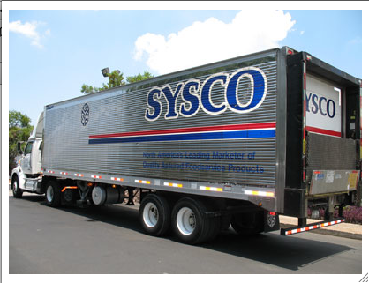
Where I work Now: Cisco
Not This Sysco

Slide 13
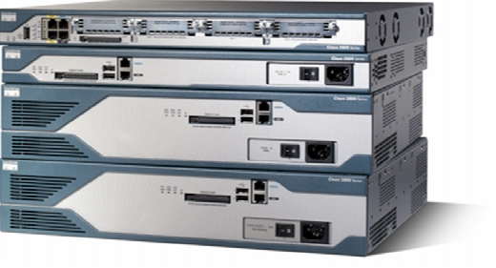
Where I work Now: Cisco
This Cisco

Slide 14
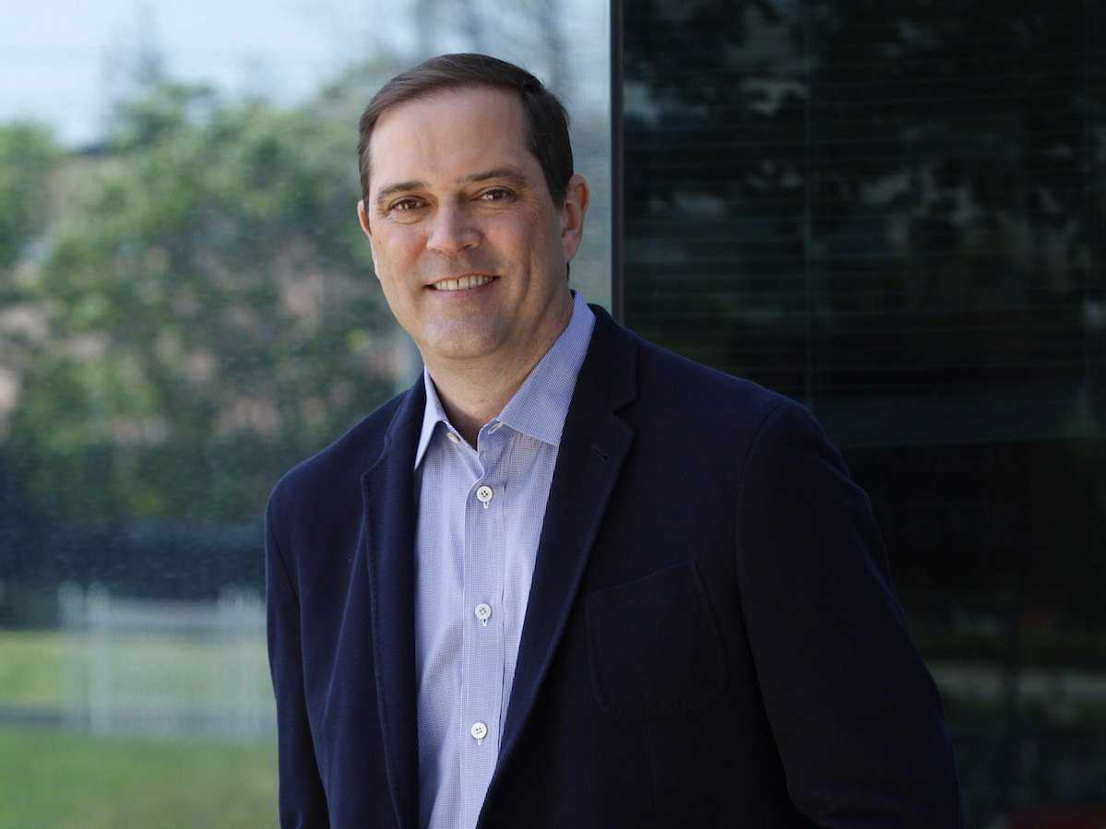
Cisco Fast Facts
CEO: Chuck Robbins
Headquarters: San Jose, CA
Yearly Revenue: $49.1 Billion 2016
Market Capitalization: $158B
Employees: ~75,000

Slide 15
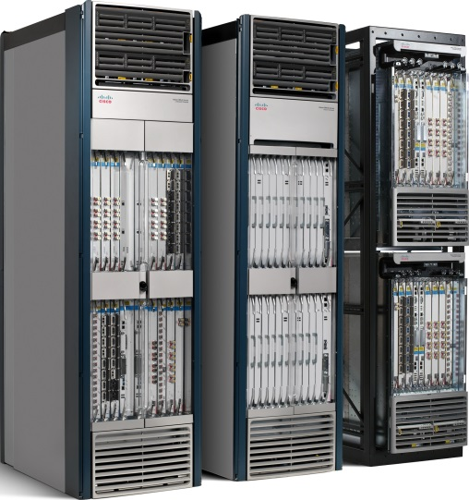
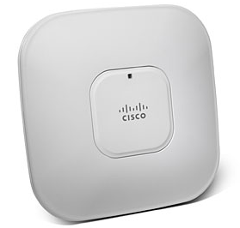
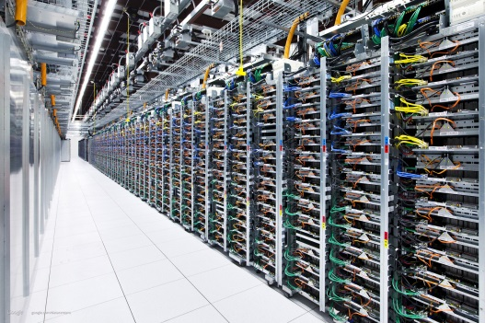
So… what does it make?
Cisco Makes all of the Stuff Under the Hood that Makes the Internet Work
A Data Center
WiFi Access Points for
Businesses
The Stuff that Walmart uses to connect its stores and customers
All the Stuff that AT&T use to
Provide you Internet access

Slide 16
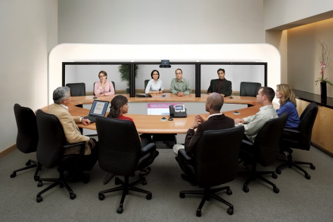
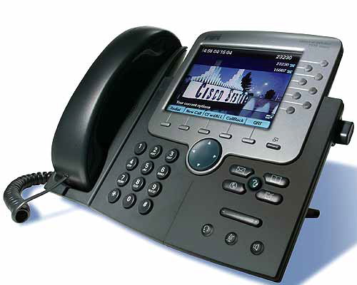
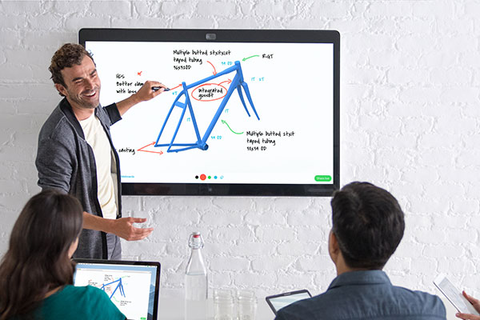
What My Business Unit Does: Collaboration
Telepresence Systems
Web Conference
Calling
Spark Board
Phones and Phone Control Software
(Freehold Township School District is a customer!)
$4B Yearly Revenue

Slide 17
A Quick Pitch…
Cisco Spark – FREE!
1-1 and persistent group chat up to 5000 people
Voice and video calling
Schedule meetings, ad-hoc meetings
File sharing and in-app preview
Photo sharing

Slide 18
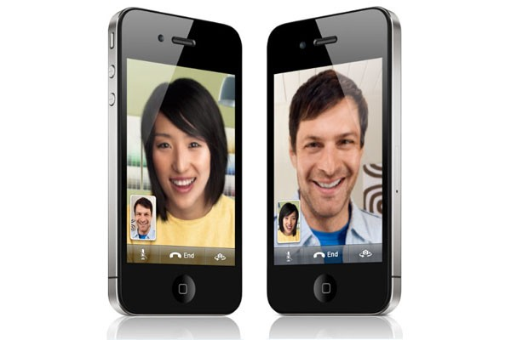
What is Voice over IP?
Making Voice and Video Calls using
Your Internet Connection
Instead of your Phone Line
IP == The Internet Protocol – the
Core Technology of the Internet

Slide 19
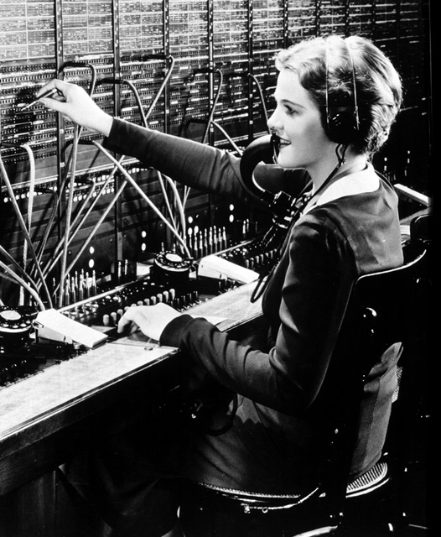
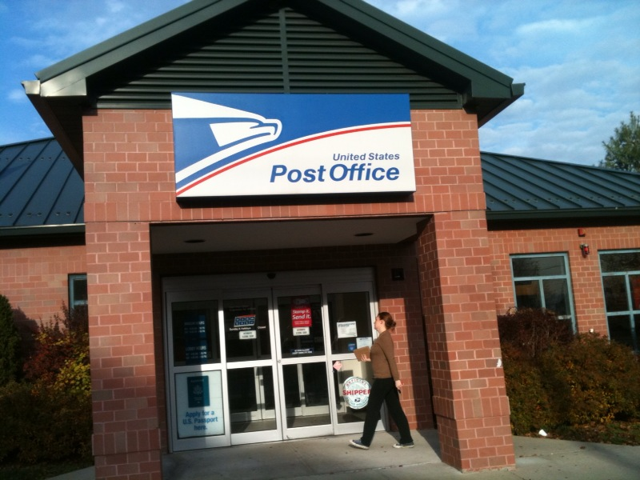
The Internet vs. the Phone Network
Phone Network: Circuit Switched
Like a wire between users
Internet: Packet Switched
Routes messages between users

Slide 20
Why Use Internet for Calling Instead of Phone Network??
Cheaper calls
As a business, one network instead of two
Better experiences (video!)
Mobility – receive my calls anywhere I have Internet

Slide 21
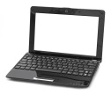
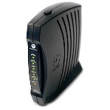
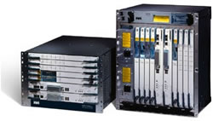
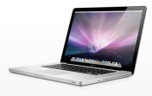
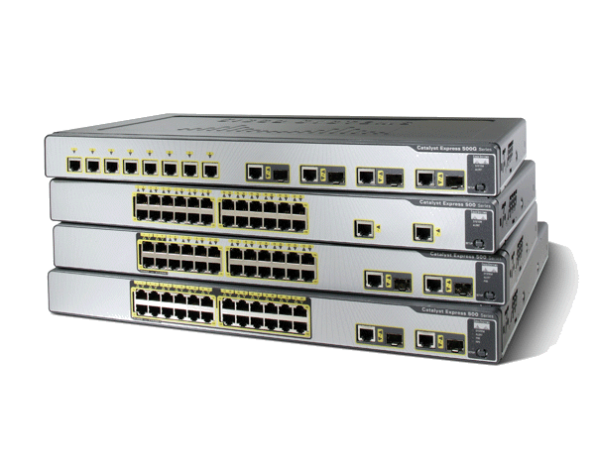
How does it work?
Access: DSL, Cable,
Fiber
Your Internet Provider’s Network
To Other Networks

Slide 22
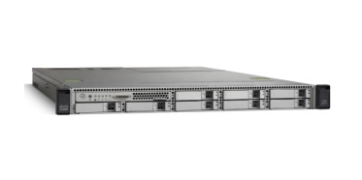
Packet Switching
Your computer
Facebook.com
Web Server

Slide 23
Packet Switching
To: fb
From: Josh
Subject: web
Header
Please fetch www.facebook.com/index.html
Payload
Internet Protocol (IP) Packet

Slide 24
Packet Switching

Slide 25
Packet Switching
Router looks at the destination address and makes a routing decision
?
?

Slide 26
Packet Switching
Packet moves from hop to hop until it reaches destination

Slide 27
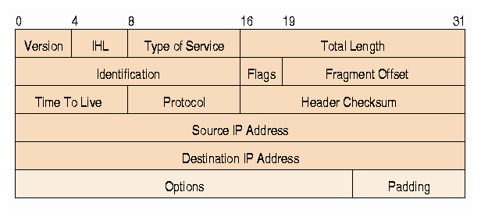
A Real Packet
The packet is sent bit at a time. We write it this way – showing each consecutive 32 bits as a row
Header
To: fb
From: Josh
Subject: web
Please fetch www.facebook.com/index.html
Body or
Payload
IP Body

Slide 28
A Real Packet
This set of 32 bits is the destination address – it’s the “To” part of the packet.
Header
To: fb
From: Josh
Subject: web
Please fetch www.facebook.com/index.html
Body or
Payload
IP Body

Slide 29
A Real Packet
This set of 32 bits is the source address – it’s the “From” part of the packet.
Header
To: fb
From: Josh
Subject: web
Please fetch www.facebook.com/index.html
Body or
Payload
IP Body

Slide 30
A Real Packet
This set of 16 bits is the protocol – it describes what comes next in the packet. It’s the “Subject” part of the packet – part of it at least.
Header
To: fb
From: Josh
Subject: web
Please fetch www.facebook.com/index.html
Body or
Payload
IP Body

Slide 31
Sidebar - what is a Protocol?
A communications protocol is a system of digital rules for data exchange between computers through a computer network
Syntax
rules to encode and decode data
Semantics
rules to process data
Type of language called ABNF which specifies protocol syntax, here for the SIP protocol
A formal model of protocol semantics using a Finite State Machine (FSM) – here for SIP transactions.

Slide 32
Why do we need Protocols?
Protocols describe the behavior of software which allows computers to talk to each other successfully to accomplish a task
Protocols need to be rigorous since computers are literal – protocols specify rules that are meant for a computer to process
Protocols need to deal with problems that might happen when computers talk to each other – loss, delay, jitter, different versions of software
Protocols are defined by a combination of computer programs (often in special languages) combined with English prose
Protocols are often standardized – agreed upon by a formalized community of computer scientists – enabling different companies to make products that work together

Slide 33
You Use Protocols Everyday
Protocol Name | Used For | Standardized In
IP – the Internet Protocol | Exchanging packets between routers | http://www.ietf.org/rfc/rfc791.txt
HTTP – the Hypertext Transfer Protocol | Requesting and transferring documents from a web server to browser | http://www.ietf.org/rfc/rfc2616.txt
DNS – the Domain Name System | Allowing a computer to convert a human readable name (like www.twitter.com) to an IP address | https://www.ietf.org/rfc/rfc1034.txt
SMTP – the Simple Mail Transfer Protocol | Sending mail between two computers | http://www.ietf.org/rfc/rfc2821.txt
TCP – the Tranport Control Protocol | Reliable transmission of a stream of bytes

Slide 34
Where do the protocols on the Internet come from?
The Internet Engineering Task Force (IETF)
An informal collection of engineers and computer scientists from around the world that define the rules that govern the Internet and oversee its operation
In existence since 1986
The standards it produces are called RFCs
8174 RFCs produced so far

Slide 35
An Example Page of SIP
And now back to the IP packet…..

Slide 36
The IP Address
Every device on the Internet has an IP address
The IP address is 32 bits long and uniquely identifies the device on the Internet
If a device has multiple connections to the Internet (think: your iPhone has WiFi and LTE), it has one IP address per connection – this is called an interface
The routers and switches themselves also have an IP address – one on each interface
With 32 bits there are 2³² IP addresses available – or 4.2 Billion addresses – and we’re almost out of them!!

Slide 37
IP Address Notation
This is the actual IP address of facebook.com in the US
31.13.69.228
We write it as four numbers separated by periods
Four numbers, each of
Which has 256 values, gives us all 2³² addresses
Each number is between 0 and 255.
That’s 256 numbers, or 2⁸

Slide 38
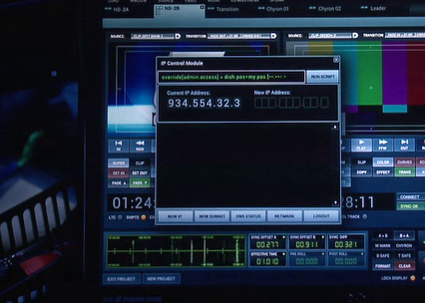
IP Address in Iron Man 3!
Hmm – what’s wrong with this?

Slide 39
IP Address Blocks
Notation | Means | Number of addresses in this block | Known as
173/8 | The 2²⁴ addresses from 173.0.0.0 to 173.255.255.255 | 2²⁴ = 16.7 million | Class A network
173.252/16 | The 2¹⁶ addresses from 173.252.0.0 to 173.252.255.255 | 65,636 | Class B network
173.252.110/24 | The 2⁸ addresses from 173.252.110.0 to 173.252.110.255 | 256 | Class C network

Slide 40
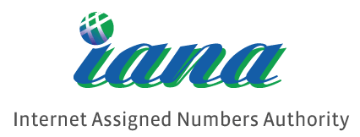
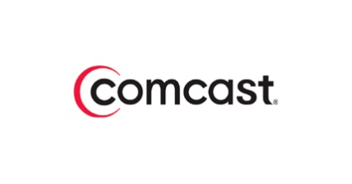
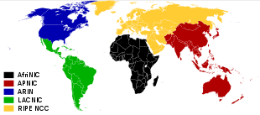
IP Address Assignment
IANA is the international body that oversees all IP address allocation. They allocate large blocks to:
The RIRs, which manage geo-specific allocation to:
Regional Internet Registries (RIRs)
ISPs, which then allocates one to
Your internet router

Slide 41
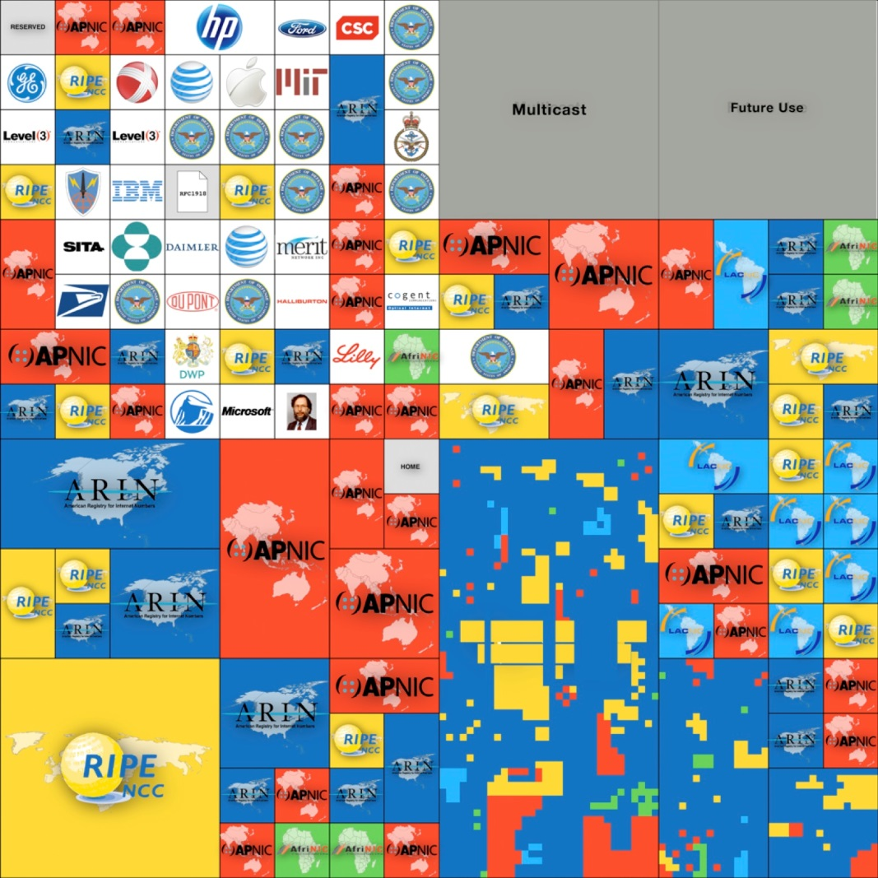
IP Address Map
Each little block represents a /8 –They are now all allocated.

Slide 42
Back to Routers for a Moment
Packets arrive at the inputs and are moved to the correct output

Slide 43
Back to Routers for a Moment
But what if more than one of the inputs needs to go to the same output?

Slide 44
Queues
The router has buffers, also called queues – which holds packets until they can be sent

Slide 45
Uh Oh - Congestion
If a the queue is full when the next packet shows up – its dropped! This is called congestion, and it causes packet loss.

Slide 46
Uh Oh - Delay
Congestion also causes delay. If there is a lot of packets in the queue, the new packet has to wait a bit to get sent. If there arent any packets, it can get sent fast.

Slide 47
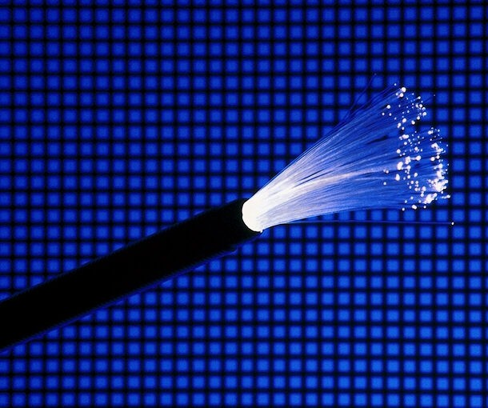
More Delay – that Pesky Speed of Light!
Speed of light in vacuum = 300,000 km/s (186,000 miles/sec)
Speed of light in an optical fiber = 200,000 km/s
Distance from Sydney to New York = 16,000 km
Time for speed of light to travel from Sydney – New York = 80ms
80ms is a lot – more soon!

Slide 48
More Uh Ohs - Jitter
Jitter is defined as variation in delay
Packet Number | Delay
1 | 33ms
2 | 31ms
3 | 40ms
4 | 39ms
Jitter is 9 ms
(40ms – 31ms)

Slide 49
Back to The IP Packet
This set of 16 bits is the protocol – it describes what comes next in the packet. It’s the “Subject” part of the packet – part of it at least.
IP Body

Slide 50
The Two Big Protocols – TCP and UDP – the Middleware of the Internet
The Transmission Control Protocol (TCP)
The Unreliable Datagram Protocol (UDP)
Stream Oriented – sequence of bytes
Packet Oriented – sequence of packets
Reliable – Retransmit lost data
Unreliable – no retransmissions
Rate control – limits how fast you can send to not clog the Internet
No Rate control – care needed not to clog the Internet
Connection oriented – computers exchange messages to “set it up” first and “end it” when done
Connectionless – just send it and go

Slide 51
Protocol Layering
HTTP
SMTP
DNS
RTP
Each protocol runs “on top of” the ones below
TCP
UDP
Internet Protocol

Slide 52
Analogy for Protocol Layering

Slide 53
Protocol Layering
IP Header
IP Body
TCP Header
TCP Body
HTTP Header
HTTP Body

Slide 54
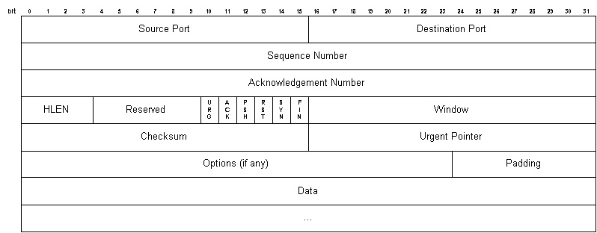
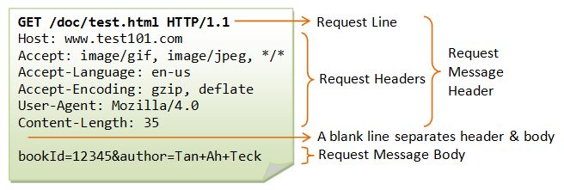
On-the-Wire
First we send these bits – the IP header
The body of the IP packet is a TCP message – so next we send the TCP header
The body of the TCP message is the content to send – an HTTP message. It is the HTTP header, followed by the HTTP body

Slide 55
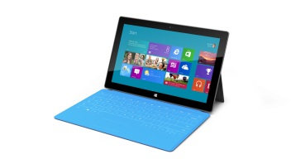
And Now – Voice over IP
Josh’s
Surface
Skype
Server
Jordan’s
iPhone

Slide 56
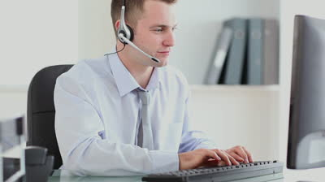
What we want to Happen
Did you see my new computer?
Packets containing Josh’s words
new
my
see
You
Did
Fast!

Slide 57
How Fast?
Good
OK
Bad

Slide 58
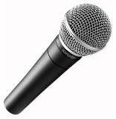
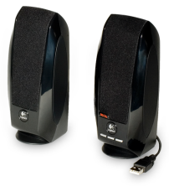
Software Components
Software on Josh’s Computer
Speech Encoder
Gain Control
Analog to Digital
Noise Removal
Echo Cancellation
Packetizer
Network introduces delay, loss, jitter
Digital to Analog
Jitter Buffer
Speech Decoder
Loss Recovery
Depacketizer
Software on Jordan’s Computer

Slide 59
Software Components
Software on Josh’s Computer
Speech Encoder
Gain Control
Analog to Digital
Noise Removal
Echo Cancellation
Packetizer
Network introduces delay, loss, jitter
Digital to Analog
Jitter Buffer
Speech Decoder
Loss Recovery
Depacketizer
Software on Jordan’s Computer

Slide 60
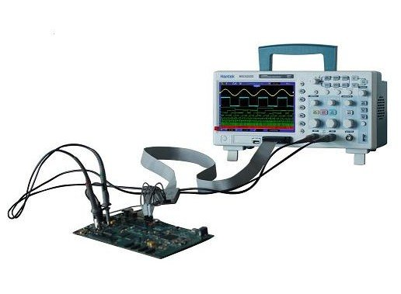
What is “Analog”?
An analog signal is a variable voltage on a wire, often measuring something in the real world
Examples:
The wiring in your home
The output of an electro cardiogram that measures your heartbeat

Slide 61
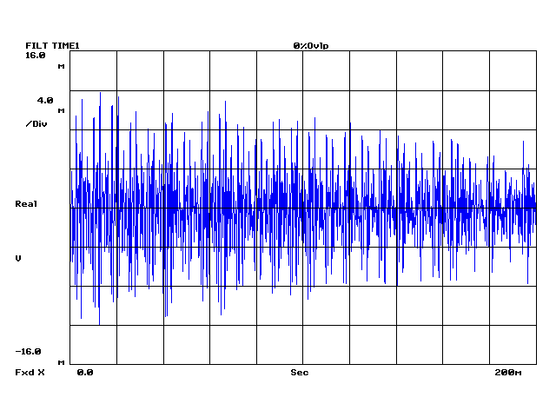
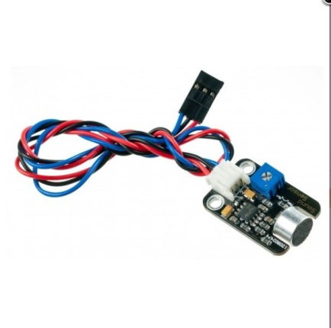
Speech Starts out as Analog Too

Slide 62
Analog to Digital - Sampling
XX milliseconds
Every XX milliseconds, record the value of the analog signal using a binary number of length YY bits

Slide 63
How often do we need to sample?
Signal repeats every second
We need to sample twice a second
A famous math theorem shows that – we need to sample twice as often as the highest frequency of the signal

Slide 64
So – what is the highest frequency in voice?
Most speech is below 4000Hz
But not all
Range of Human Hearing
Teenage hearing
Range of Human Speech
20Hz
4000Hz
20,000Hz
Frequency

Slide 65
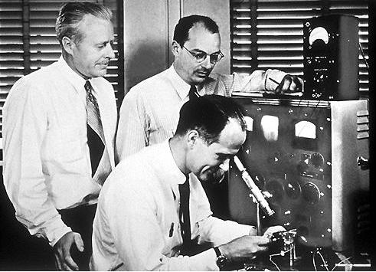
The Big Decision 60 Years Ago
Conversion of telephone network from analog to digital in 1950s
AT&T Engineers decide to cut off all speech above 4kHz
Send digital speech through phone network with 8 bits per sample
(8 bits * 2 * 4 kHz) = 64 kbps

Slide 66
And so all speech on the phone network is like this
Everything above 4kHz is gone
This is called Narrowband Voice.
Range of Human Speech
20Hz
4000Hz
20,000Hz
Frequency

Slide 67
With Voice over IP we can do better.
Skype, Facetime and others keep it all.
This is called Wideband Voice.
Range of Human Speech
20Hz
4000Hz
20,000Hz
Frequency

Slide 68
Does it Matter? You decide!
Narrowband Voice
Wideband Voice

Slide 69
Software Components
Software on Josh’s Computer
Speech Encoder
Gain Control
Analog to Digital
Noise Removal
Echo Cancellation
Packetizer
Network introduces delay, loss, jitter
Digital to Analog
Jitter Buffer
Speech Decoder
Loss Recovery
Depacketizer
Software on Jordan’s Computer

Slide 70
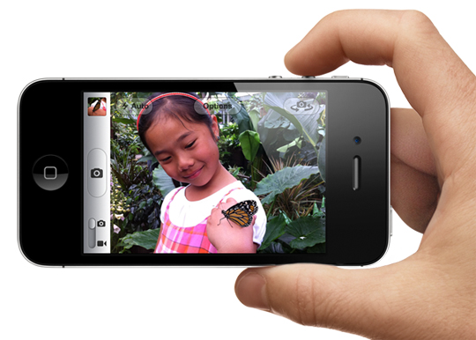
The Echo Problem
Hi Daddy look at the butterfly
Sound comes out of the speaker
And the mic picks it up
The girl will hear what she said echoed back to her!

Slide 71
Echo Canceller Software
-
Learning Module figures out the acoustic properties of the room by listening
Volume Control
Set Volume
Learning Module
Delay
Set Delay
Software on Ethan’s Computer

Slide 72
Software Components
Software on Josh’s Computer
Speech Encoder
Gain Control
Analog to Digital
Noise Removal
Echo Cancellation
Packetizer
Network introduces delay, loss, jitter
Digital to Analog
Jitter Buffer
Speech Decoder
Loss Recovery
Depacketizer
Software on Jordan’s Computer

Slide 73
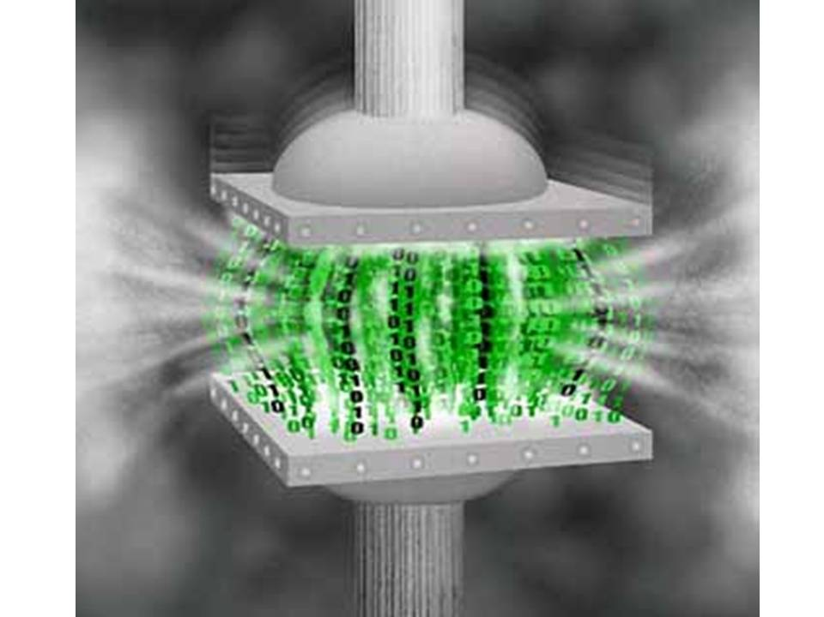
Speech Coding – What is it?
Wideband Speech
300 kbps
Compressed
Wideband Speech
40 kbps
This is a lot! More than many home broadband speeds.
Compressed or coded speech takes up less bandwidth.

Slide 74
Lossless Coding
Original Content
Original Content
Coder
Compressed Content
Decoder
In Lossless Coding, you get back the exact same thing (bit by bit) after applying compression and then decompression.
The combination of a coder and decoder is called a codec.

Slide 75
Lossy Coding
Original Content
Almost Original Content
Code
Compressed Content
Decode
In Lossy Coding, you don’t get back the exact same thing (bit by bit) after applying compression and then decompression. Lossless compression can compress even more than lossy.

Slide 76
Guess the Type!
??
ZIP

Slide 77
Guess the Type!
LOSSLESS
ZIP

Slide 78
Guess the Type!
??
JPG

Slide 79
Guess the Type!
LOSSY
JPG

Slide 80
Guess the Type!
??
PNG

Slide 81
Guess the Type!
LOSSLESS
PNG
This is why PNG files are larger than JPG for the same image.

Slide 82
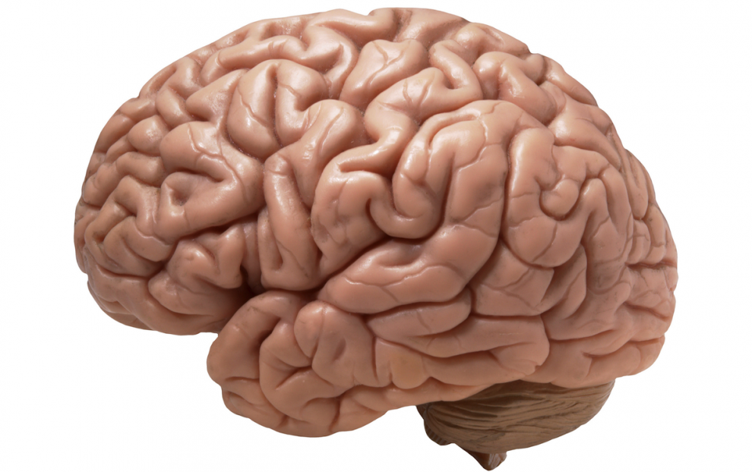
How do we do lossy compression of voice?
You might hear two sounds that – to you – sound alike – even though a computer would think they are different!
The behavior of the brain in recognizing speech is very well understood
We can remove information from the speech that we know you’re brain won’t notice!
Your brain is not like a computer.

Slide 83
But how does it work?
The encoder listens to you talk and builds a mathematical model of your vocal system!
It then sends the parameters of this model to the decoder which rebuilds the speech.
Example: your pitch – or core frequency of your voice.

Slide 84
Encoding Speech Frames
Encoder
10ms
10ms
10ms
10ms
10ms
10ms
Your speech is broken into 10ms
frames of uncompressed speech
Each of these frames is compressed by sending the parameters of the mathematical model.
Decoding one frame however relies on having gotten the previous one!

Slide 85
Speech Coding Fun Facts
Speech coding is an arcane field of mathematics and computer science that is understood by very few people in the world
There are many speech codecs, and they usually have funny monikers like “G.729” and “OPUS”
The codec used in most cell phone networks is called AMR and it can compress your voice as low as 4.75 kbps
Speech codecs have traditionally been different from music codecs; speech codecs due a bad job at music. This is why music-on-hold on the telephone sounds so awful

Slide 86
Voice Activity Detection and Comfort Noise
Speech Magnitude (dB)
Speech Detected
Hang-Over
Speech Detected
Hang-Over
Typically fixed
at 200 ms
Sentence 1
Sentence 2
Signal-to-
Noise
Threshold
Noise Floor
time
Front-end
Speech Clipping
Front-end
Speech Clipping

Slide 87
Video Coding

Slide 88
Key Terms
Term | Description
Frame | An individual picture in a sequence that makes up the video
Frame Rate | The number of frames per second in video. 30 is excellent (TV quality)
Resolution | The number of horizontal and vertical pixels. VGA=640x480.
Interlacing | A mechanism for transmitting video by splitting a frame into two fields, one field representing the odd lines, and one the even field. This is the “i” in 1080i
Progressive | As opposed to interlaced, a method for transmitting video by sending each frame as a whole.
HD | High Def resolutions – 720p is 1280x720 with 60fps. 1080i is 1920x1080 at 30fps

Slide 89
Key Concept: Macroblocks
Rectangular block in an image which is a basic unit of compression. Typically 16x16 pixels.

Slide 90
Key Concept: Inter-Frame Prediction
Encode
Predict information in the current frame by looking at previous frames, possibly taking into account motion.

Slide 91
Key Concept: Discrete Cosine Transform (DCT)
Increasing horizontal frequencies
A technique for representing a macroblock by its component frequencies. Discarding the higher frequencies throws away the finer details without losing the core image.
Increasing vertical frequencies

Slide 92
Video Coding Fun Facts
Encoding (compressing) requires much more computational horsepower than decoding (decompressing)
Video coding is a highly patented area and this has made it very difficult for everyone to agree on which one to use
The primary video code in usage today is called H.264 and most video on the Internet uses it
Speech coding is mature and many consider it “done”. Video coding is still an area of research and innovation.

Slide 93
Signaling
In VoIP, Signaling is the process of controlling the flow of voice and video packets.
Signaling includes discovery, setting up the call, tearing it down, and related functions.
Signaling in VoIP is done using the Session Initiation Protocol (SIP).

Slide 94
SIP Basics
Josh’s
Surface
SIP
Server
Jordan’s
iPhone

Slide 95
Lets Simplify
Josh’s
Surface
SIP
Server
Jordan’s
iPhone

Slide 96
Josh Wants to call jordan@gmail.com
Josh’s
Surface
SIP
Server
Jordan’s
iPhone

Slide 97
How does Josh’s computer find Jordan’s phone??
Josh’s
Surface
SIP
Server
Jordan’s
iPhone

Slide 98
Registration
Josh’s
Surface
SIP
Server
REGISTER
jordan@gmail.com
I’m 1.2.3.4
Jordan’s
iPhone

Slide 99
Registration
Hard Drive
jordan@gmail.com
is 1.2.3.4
Josh’s
Surface
SIP
Server
Jordan’s
iPhone

Slide 100
Josh makes the call
INVITE
jordan@gmail.com
I’m 5.4.3.2
Josh’s
Surface
SIP
Server
Jordan’s
iPhone

Slide 101
SIP Server Looks up Jordan
Hard Drive
jordan@gmail.com
is 1.2.3.4
Josh’s
Surface
SIP
Server
Jordan’s
iPhone

Slide 102
SIP Server Sends to Jordan’s phone
Josh’s
Surface
SIP
Server
INVITE
jordan@gmail.com
I’m 5.4.3.2
Jordan’s
iPhone

Slide 103
Ring!
Josh’s
Surface
SIP
Server
Ring
Jordan’s
iPhone

Slide 104
Jordan accepts the call
Josh’s
Surface
SIP
Server
200 OK
I’m 1.2.3.4
Jordan’s
iPhone

Slide 105
SIP Server tells Josh
200 OK
I’m 1.2.3.4
Josh’s
Surface
SIP
Server
Jordan’s
iPhone

Slide 106
Voice and Video Packets sent
Josh’s
Surface
SIP
Server
Voice and
Video packets
Jordan’s
iPhone

Slide 107
Summary
Voice over IP (VoIP) is using the Internet to make phone calls
VoIP has many benefits including cheaper calls, better experiences, mobility, and network unification
Low delay is a big requirement for VoIP
Voice and video are sent using codecs, which perform lossy compression
Setup of a call is done using signaling protocols – notably SIP

